Slide 1
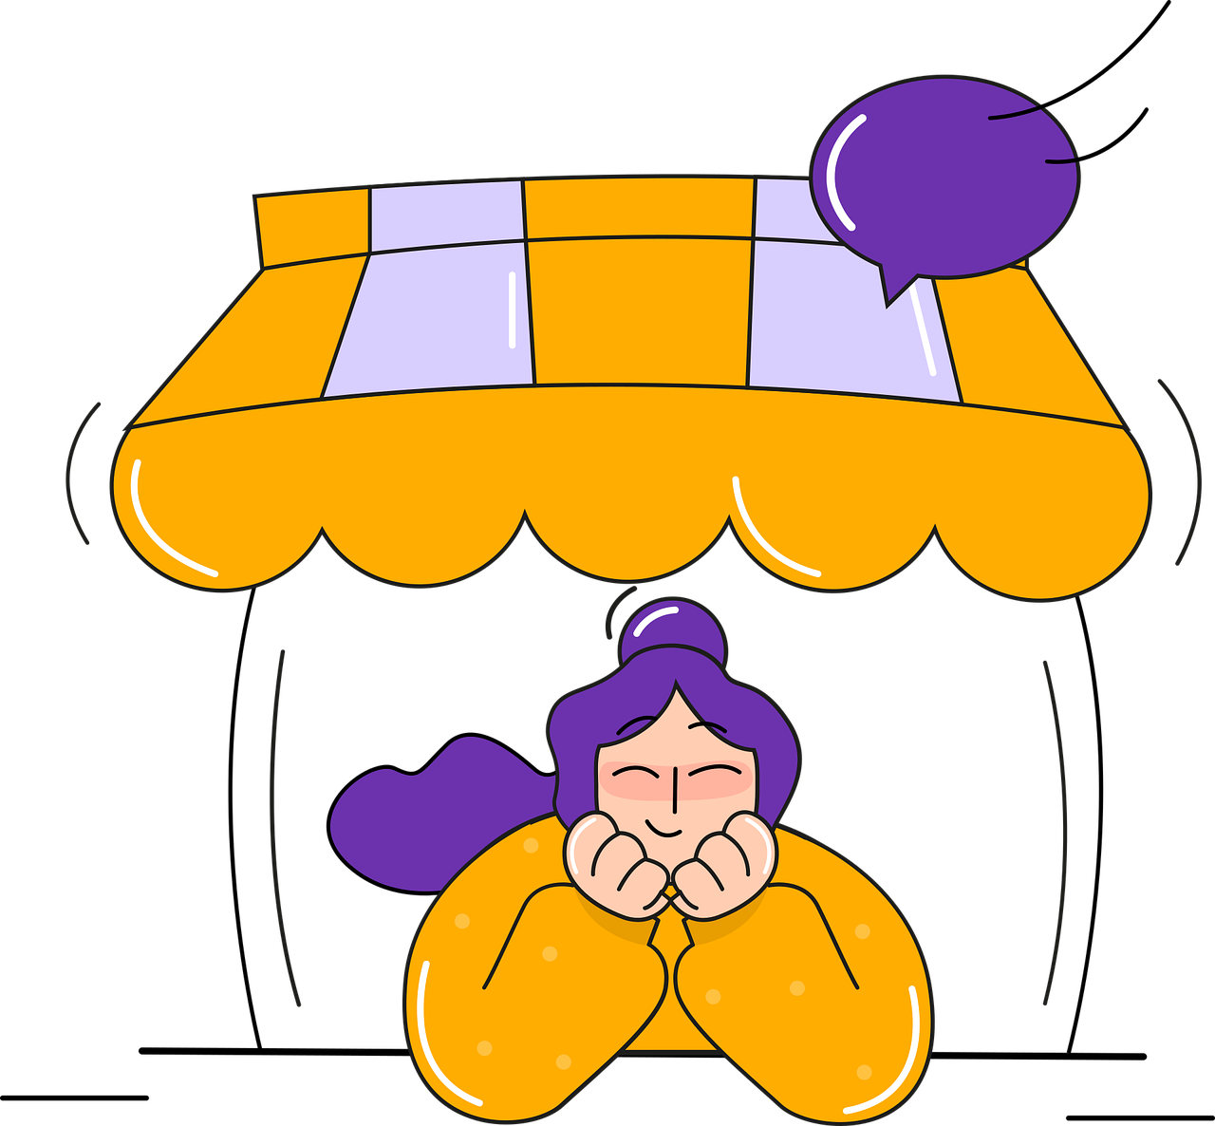
CUSTOMER ACQUISITION ANALYSIS
PRESENTED BY: Shubham Upadhayay
PROJECT FILE: CUSTOMER ACQUISITION DATA ANALYSIS

Slide 2

OBJECTIVE
Examine the dataset thoroughly to generate a comprehensive report on customer purchasing power. This report should include in-depth analysis and insights, supplemented by visual representations such as charts and graphs to clearly illustrate trends and patterns.

Slide 3

PROBLEM STATEMENT
1. Make a Visualization for the distribution of customer Acquisition costs.
2. Compare the cost of acquisition across various channels and determine which ones are the most and least profitable.
3. Find out which channels are most and least effective at converting customers.
4. Calculate the total revenue by channel and analyze the most and least profitable channels in terms of generating revenue.
5. Calculate the return on investment (ROI) for each channel.

Slide 4
DISTRIBUTION OF CUSTOMER ACQUISITION COST.
OBSERVATION
1.Product or Service Pricing:
If this data reflects the costs of products or services, it suggests there may be a popular price point of around 10 units (whatever the unit of measurement is). This could be attributed to customer demand, competitive pricing, or product positioning.
2.Marketing Budget Allocation:
If this data pertains to marketing budgets, it may indicate that a significant portion of the budget is allocated to campaigns that cost around 10 units. This could result from these campaigns being effective in acquiring customers or generating leads, or it might simply reflect the organisation’s overall marketing strategy
3.Acquisition Channels:
The distribution of costs could also illustrate the different acquisition channels utilised. For instance, if the cost range of around 10 units is linked to online advertising, it might suggest that this channel is a major driver of acquisitions.

Slide 5
CUSTOMER ACQUISITION COST BY CHANNEL
OBSERVATION
1. Paid Advertising:
This channel has the highest acquisition cost, with the bar reaching the top of the chart. This indicates that acquiring customers through paid advertising is the most expensive channel among the four.
2. Email Marketing and Referral:
These two channels have relatively similar and lower acquisition costs compared to paid advertising. The bars for these channels are shorter, indicating lower costs.
3. Social Media:
The acquisition cost for social media falls somewhere between email marketing/referral and paid advertising. The bar for social media is taller than those for the former two but shorter than the one for paid advertising.

Slide 6
CONVERSION RATE BY CHANNEL
OBSERVATION
Highest Conversion Rate: Social media has the highest conversion rate among the four channels. The bar for social media is significantly taller than the others, indicating a higher proportion of conversions compared to the other channels.
Referral and Paid Advertising: These two channels have similar conversion rates, which are higher than email marketing but lower than social media. The bars for these channels are of comparable height, suggesting that they perform similarly in terms of conversions.
Email Marketing: Email marketing has the lowest conversion rate among the four channels. The bar for email marketing is the shortest, indicating a lower proportion of conversions.

Slide 7
TOTAL REVENUE BY CHANNEL
OBSERVATION
Dominant Channel: Social media is the top-performing channel in terms of revenue generation, contributing 27.3% of the total revenue. Its slice is the largest in the pie chart.
Close Contenders: Referral and paid advertising follow closely behind social media, with 25.26% and 24.8% of the total revenue, respectively. Their slices are almost equal in size.
Email Marketing: Email marketing has the lowest contribution to total revenue, accounting for only 22.26%. Its slice is the smallest in the chart.

Slide 8
RETURN ON INVESTMENT BY CHANNEL
OBSERVATION
Highest ROI: Email marketing has the highest ROI among the four channels. The bar for email marketing is significantly taller than the others, indicating a higher return on investment.
Moderate ROI: Referral and social media have moderate ROI compared to email marketing. The bars for these channels are of similar height, suggesting that they perform similarly in terms of ROI.
Lowest ROI: Paid advertising has the lowest ROI among the four channels. The bar for paid advertising is the shortest, indicating a lower return on investment.

Slide 9
CONCLUSION
In conclusion, customer acquisition is a critical component of any business strategy. By understanding the customer acquisition process and leveraging data-driven insights, businesses can optimise their marketing efforts, reduce costs, and drive long-term growth. Ultimately, a customer-centric approach to acquisition is essential for building a loyal customer base and achieving sustainable success.

Slide 10
THANKYOU SO MUCH

